Slide 1
Chapter 3 Branch Loop, and IO Port

Slide 2
Sections
3.1 Loop and Jump Instructions
3.2 IO PORT
3.3 Time Delay Generation and Calculation

Slide 3
Sections
3.1 Loop and Jump Instructions
3.2 IO PORT
3.3 Time Delay Generation and Calculation

Slide 4
Branch instruction and Looping
Looping in PIC
Loop inside loop
Other conditional jumps
All conditional branches are short jumps
Calculating the short branch address
Unconditional branch instruction

Slide 5
Loop in PIC
Repeat a sequence of instructions or a certain number of times
Two ways to do looping
Using DECFSZ instruction
Using BNZ\BZ instructions

Slide 6
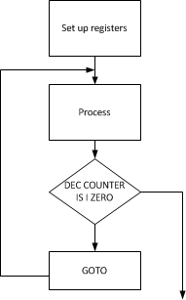
DECFSZ instruction
Decrement file register, skip the next instruction if the result is equal 0
DECFSZ fileRef, d
GOTO instruction follows DECFSZ

Slide 7
DECFSZ instruction
Example:
Write a program to
a)Clear WREG
b)Add 3 to WREG ten times and place the result in
COUNT EQU 0x25
MOVLW d'10‘
MOVWF COUNT
MOVLW 0
AGAIN ADDLW 3
DECFSZ COUNT, F
GOTO AGAIN
MOVWF PORTB

Slide 8
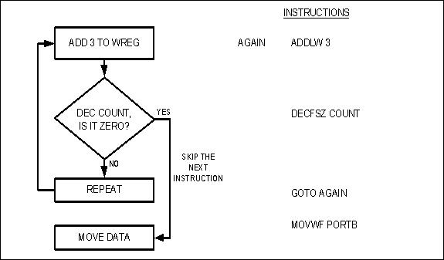
DECFSZ instruction

Slide 9
DECFSZ instruction
What is the maximum number of times that the loop in the previous example can be repeated?
Solution:
Since COUNT holds is an 8-bit register, it can hold a maximum of FFH, therefore the loop can be repeated a maximum of 256 times by setting COUNT=0.
Thus, COUNT＝0H, FFH, FEH, ..., 2, 1, 0（total 256 times)

Slide 10
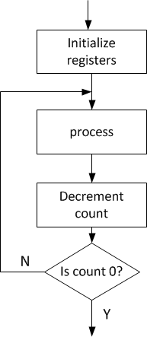
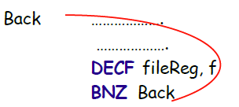
Using BNZ\BZ
Supported by PIC18 families Early families such as PIC16 and PIC12 doesn’t support these instruction
These instructions check the status flag

Slide 11
Using BNZ\BZ
Example:
Write a program to
a)Clear WREG
b)Add 3 to WREG ten times and place the result in
COUNT EQU 0x25
MOVLW d'10‘
MOVWF COUNT
MOVLW 0
AGAIN ADDLW 3
DECF COUNT, F
BNZ AGAIN
MOVWF PORTB

Slide 12
Branch instruction
What is the maximum number of times that the loop in the previous example can be repeated?
Solution:
Since COUNT holds is an 8-bit register, it can hold a maximum of FFH, therefore the loop can be repeated a maximum of 256 times by setting COUNT=0.
Thus, COUNT＝0H, FFH, FEH, ..., 2, 1, 0（total 256 times)

Slide 13
Nested Loop
A single loop is repeated 256 times in maximum.
If we want to repeat an action more times than 256, we use a loop inside a loop.
This is called nested loop.
For Example:
The inner loop is 256
The outer loop is 2
Total 256*2=512
outer loop
inner loop

Slide 14
Loop inside a loop
Write a program to
a)Load the PORTB SFR register with the value 55H
b)Complement PORTB 700times
R1 EQU 0x25
R2 EQU 0x26
COUNT_1 EQU d'10'
COUNT_2 EQU d'70'
MOVLW 0x55
MOVWF PORTB
MOVLW COUNT_1
MOVWF R1
LOP_1: MOVLW COUNT_2
MOVWF R2
LOP_2: COMF PORTB, F
DECF R2, F
BNZ LOP_2
DECF R1, F
BNZ LOP_1
LOP_1
Set R2 to ,#70
LOP_2
DECF R2, BNZ LOP_2
DECF R1, BNZ LOP_1

Slide 15
Other Conditional jumps
All of the 10 conditional jumps are 2-byte instructions
They requires the target address
1 byte address (short branch address)
Relative address
Recall: MOVF will affect the status Reg.
In the BZ instruction, the Z flag is checked. If it is high, that is equal 1, it jumps to the target address.

Slide 16
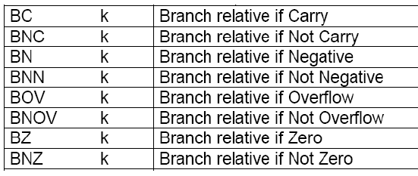
Flags Bits and Decision

Slide 17
BZ
Jump if previous result is 0
MOVF PORTB, W
BZ NEXT
MOVLW 55H
MOVWF PORTC
NEXT: ……
MOVF PORTB, W
Jump if W＝0
Test
Not Jump if W ≠0
PORTC=55H
NEXT
Notes:
MOV R2,#02H ;R2=2
CLR A ;A=0
HERE: INC A ;increase A by 1
DJNZ R2,BACK ;Decrement R2 and Jump to HERE if R2≠0

Slide 18
BNZ
Jump if previous is not zero
MOVF PORTB, W
BNZ NEXT
MOVLW 55H
MOVWF PORTC
NEXT: …
This instruction examines the contents of the ACC and jumps if ACC is not 0.
MOVF PORTB, W
Jump if W ≠ 0
Test
Not Jump if W = 0
PORTC=55H
NEXT
Notes:
MOV R2,#02H ;R2=2
CLR A ;A=0
HERE: INC A ;increase A by 1
DJNZ R2,BACK ;Decrement R2 and Jump to HERE if R2≠0

Slide 19
BNC
Jump if no carry（CY=0）
MOVLW FFH
ADDLW 01H
BNC NEXT
INCF R5
NEXT: ...
CY is PSW.
This instruction examines the CY flag, and if it is zero it will jump to the target address.
ADDLW 01H
Jump if CY=0
Test
Not Jump if CY ≠0
INCF R5
NEXT
Notes:
MOV R2,#02H ;R2=2
CLR A ;A=0
HERE: INC A ;increase A by 1
DJNZ R2,BACK ;Decrement R2 and Jump to HERE if R2≠0

Slide 20
Example
Write a program to determine if the loc. 0x30 contains the value 0. if so, put 55H in it. (an example to show move the content to the original register, to trigger the flag)
Solution:
MYLOC EQU Ox30
MOVF MYLOC, F
BNZ NEXT
MOVLW 0x55
MOVWF MYLOC
NEXT: ……

Slide 21
Example
Find the sum of the values 79H, F5H, and E2H.
Put the sum in file register loc 5H (low byte) and 6H (high byte).
Solution:
L_Byte EQU 0x5
H_Byte EQU 0x6
ORG 0
MOVLW 0x0 ;clear (W=0)
MOVWF H_Byte,A ;clear H_Byte
ADDLW 0x79 ;W=0+79H=79H
BNC N_1 ;if CY=0,add next number directly
INCF H_Byte ;if CY=1, increment H_Byte
N_1: ADDLW 0xF5 ;W=79+F5=6E and CY=1
BNC N_2 ;if CY=0,add next number directly
INCF H_Byte ;if CY=1, increment H_Byte
N_2: ADDLW 0xE2 ;W=6E+E2=50 and CY=1
BNC OVER ;jump if CY=0
INCF H_Byte ;CY=1, increment H_Byte
OVER: MOVWF L_Byte ;Now H_Byte=2, L_Byte=50H

Slide 22
Relative Address Calculation in conditional brances Instructions
The conditional jump is a jump in which control is transferred to the target location if it meets the required condition.
BZ, BNC...
The target address cannot be farther than -256 / +254 from the current program counter
How to know the target address is out of range or not?
Ans: Assembler will tell you
How to solve the problem if our conditional jump needs to
a target address which is farther than -256 / +254 from the program counter. (Need change the logic flow of your problem. See if we have time or not)
In condition branch, the instruction is
Target address=PC+2 x(8 bit signed number)
The relative displacement is a common used technique in many processor.
8 bit Opcode | 8 bit signed number (for displacement)

Slide 23
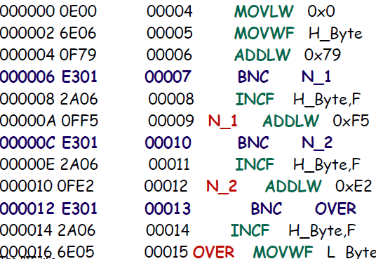
Relative Address Calculation in conditional brances Instructions
Example:
Why in ROM Loc the content is E301?
Ans:
E3 is opcode for BNC
When CPU is executing BNC N_1, the PC=00008.
The target address is 000A. The difference (000A-0008) is +2. So, the displacement in instruction is 01.

Slide 24
Relative Address Calculation in conditional brances Instructions
Example:
0000 0E00 MOVLW 0x0
0002 6E06 MOVWF H_Byte, A
0004 0F79 ADDLW 0x79
0006 E3XX BNC N_1
0008 0000 NOP
000A 0000 NOP
000C 2A06 INCF 0x6, F, ACCESS
000E 0FF5 N_1: ADDLW 0xf5
0010 E301 BNC N_2
0012 2A06 INCF 0x6, F, ACCESS
0014 0FE2 N_2: ADDLW 0xe2
0016 E301 BNC Over
0018 2A06 INCF 0x6, F, ACCESS
001A 6E05 Over: MOVWF 0x5,
000E-0008=06, 6/2 = 3 => E303

Slide 25
Relative Address Calculation in conditional brances Instructions
Example:
0000 0E00 MOVLW 0x0
0002 6E06 MOVWF H_Byte, A
0004 0F79 ADDLW 0x79
0006 E303 BNC N_1
0008 0000 NOP
000A 0000 NOP
000C 2A06 INCF 0x6, F, ACCESS
000E 0FF5 N_1:ADDLW 0xf5
0010 E301 BNC N_2
0012 2A06 INCF 0x6, F, ACCESS
0014 0FE2 N_2: ADDLW 0xe2
0016 E3XX BNC N_1
0018 2A06 INCF 0x6, F, ACCESS
001A 6E05 Over: MOVWF 0x5,
000E-0018=-10, -10/2 = -5, -5 is signed format is FB=>E3FB

Slide 26
Jump Instructions
The unconditional jump is a jump in which control is transferred unconditionally to the target location. The target address is directly coded in the instruction
There are two unconditional jumps：
GOTO（Long Jump）
BRE（Short Jump）
Examples in textbook

Slide 27
GOTO
a 4-byte instruction
The address is A₂₀-------A₁0
Jump to anywhere in the program memory
1110 1111 | A₈-----A₁
1111 | A₂₀-------------A₉
Notes:
displacement: 替換

Slide 28
BRA
a 2-byte instruction
The first 5 bits are the opcode
The next 11 bits form a signed number displacement, which (need to times 2 first ) is added to the PC to get the target address.
In condition branch, the instruction is
Target address=PC+2 x(11 bit signed number)
Limited range : -2048 to 2046 bytes of the relative address of the current PC value
5 bit Opcode | 11 bit signed number (for displacement)

Slide 29
CALL and RCALL
CALL: 4 bytes
Call a subroutine in anywhere
format is similar to GOTO
RCALL: 2 bytes
Call a subroutine who address should be within Similar to BRA
Relative address

Slide 30
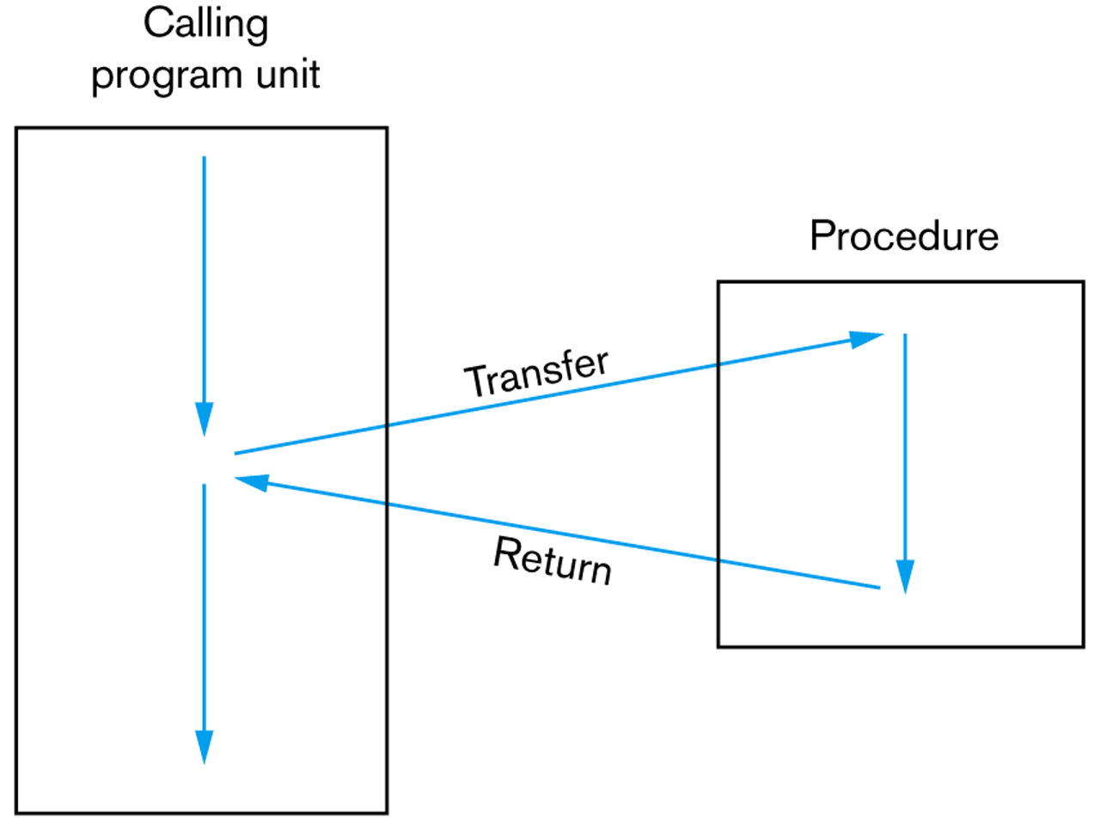
The Flow of Control Involving a Procedure


Slide 31
The Process of Calling a Subroutine
After execution of the called subroutine, the CPU must know where to com back to.
The process of calling a subroutine：
A subroutine is called by CALL instructions.
The CPU pushes the PC onto the stack (in PIC18 it is a hardware stack).
The CPU copies the target address to the PC.
The CPU fetches instructions from the new location.
When the instruction RETURN is fetched, the subroutine ends.
The CPU pops the return address from the stack.
The CPU copies the return address to the PC.
The CPU fetches instructions from the new location.

Slide 32
Sample
;MAIN program calling subroutines
ORG 0
MAIN:
:
:
CALL SUBR_1
:
CALL SUBR_2
:
:
HERE: SJMP HERE
;－－－－end of MAIN
SUBR_1: ....
....
RETURN
;－－－－end of subroutine 1
SUBR_2: ....
....
RETURM
END ;end of the asm file

Slide 33
Sample
;MAIN program calling subroutines
MYREG EQU 0x8
PORTB EQU 0xF8
ORG 0
BACK: MOVLW 0x55
MOVWF PORTB
CALL DELAY
CALL DELAY_500MS
MOVLW 0xAA
MOVWF PORTB
CALL DDELAY
GOTO BACK
DELAY:
MOVLW 0xFF
MOVWF MYREG
AGAIN:
NOP
NOP
DECF MYREG, F
BNZ AGAIN
RETURN
END

Slide 34
Sections
3.1 Loop and Jump Instructions
3.2 IO PORT
3.3 Time Delay Generation and Calculation

Slide 35
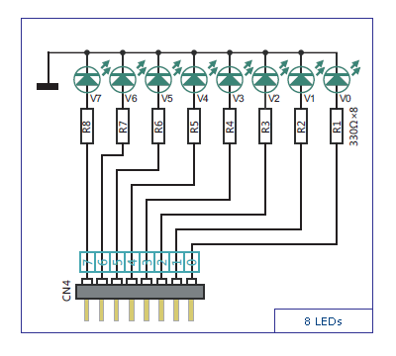
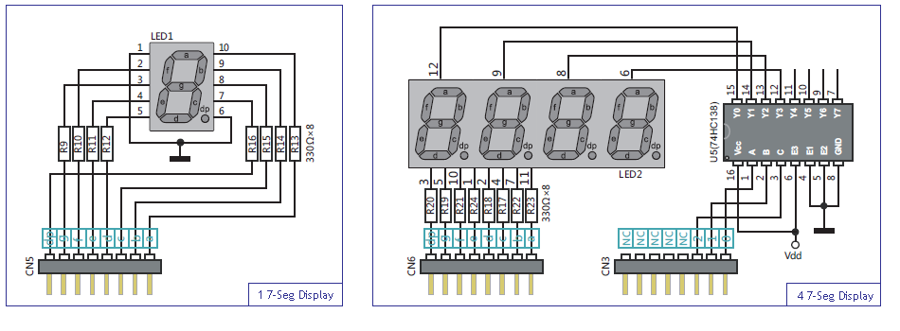
PIC18 Parallel Ports
I/O ports are available in PIC18 to interact, monitor and control peripherals.
LED
7-Segment LED

Slide 36
PIC18 Parallel Ports
The number of ports in the PIC18 family depends on the number of pins on the chip.
PIC18F4520 has five ports: Port A-E
Different ports have different number of pins:
Port A: 7 pins
Port B, C, D: 8 pins
Port E: 3 pins

Slide 37
PIC18 Parallel Ports
The behaviour of each port is controlled by two special function registers (SFRs):
PORTx – indicates the voltage levels on the pins of the device
TRISx – data direction register
e.g., For Port B, we have PORTB and TRISB

Slide 38
TRISx and PORTx SFRs
Each of the Ports A-E can be used for input and output.
TRISx SFR is used for designating the direction of a port
0 for output (e.g., Controlling LED state)
1 for input (e.g., Key scan)
e.g., To output data to Port B:
Write 0s to TRISB SFR
Write data to PORTB SFR
Notes:
Input – get voltage level from a peripherial
Output – assign a voltage level of a designated port

Slide 39
TRISx and PORTx SFRs
e.g., output the hex value 0x26 to Port C
clrf TRISC
movlw 0x26
movwf PORTC
e.g., Read the current value of Port D into WREG register
setf TRISD
movf PORTD, W

Slide 40
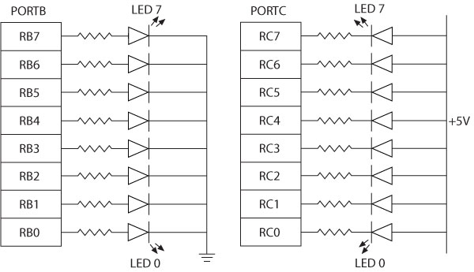
Interfacing with LED
Two ways of connecting LEDs to I/O ports:
Common Cathode: LED cathodes are grounded and logic 1 from the I/O port turns on the LEDs.
Common Anode: LED anodes are connected to the power supply and logic 0 from the I/O port turns on the LEDs.
Common Cathode
Common Anode
Active high
Active low

Slide 41
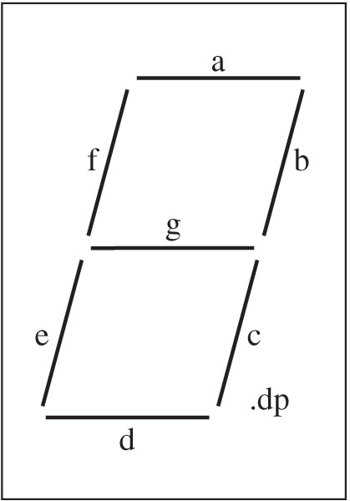
Interfacing with 7-Segment LED
Often used to display BCD numbers (1 through 9) and a few alphabets
A group of eight LEDs physically mounted in the shape of the number eight plus a decimal point
Each LED is called a segment and labeled as ‘a’ through ‘g’.

Slide 42
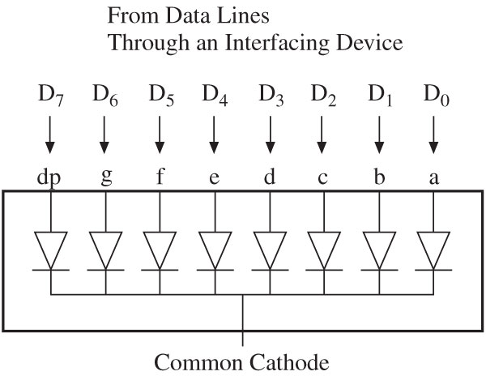
Interfacing with 7-Segment LED
In a common cathode seven-segment LED
All cathodes are connected together to ground and the anodes are connected to data lines
Logic 1 turns on a segment.
Example: To display digit 1, all segments except b and c should be off.
Byte 00000110 = 06H will display digit 1.

Slide 43
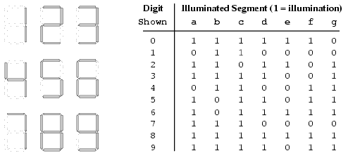
Interfacing with 7-Segment LED

Slide 44
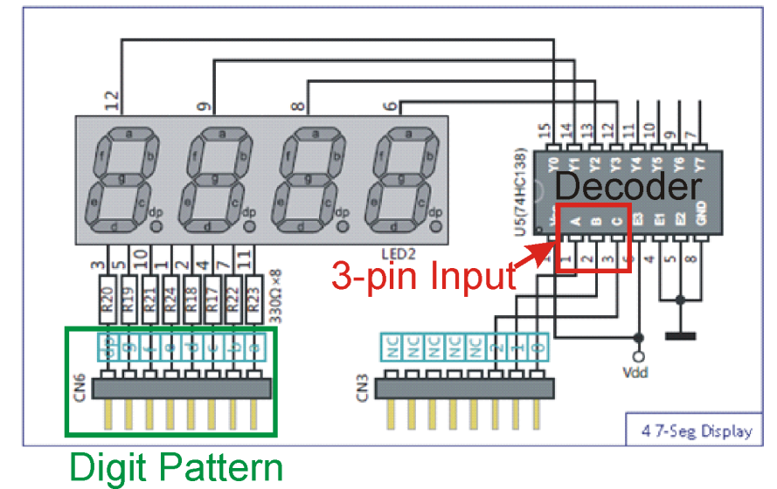
Interfacing with 4-digit 7-Segment LED
Decoder selects the position where digit pattern is displayed.
Use time multiplexing if we need to display all four digits.
Notes:
4552 – display 4 first 2ms ; change position display 5 for 2ms; etc
Describe mechanism.
If the digit moves quickly enough, the 4 digits would appear to
Let us step back a bit. Why do we need time multiplexing.
Interfacing with 4 digit 7 segment led
Each digit is controlled by 7 leds. If we need to control 4 digits, we need 28 pins in total. Too much for a 40-pin microcontroller. Solution is time multiplexing…..
What is time multiplexing????
Only one digit appears at any given time. The digit pattern is controlled by this input.
and we try to perform something like this…..
Digit 1 digit for 2ms then 2nd digit for 2ms …..
You are able to see all 4 digits appearing simultaneously because of an effect called Persistence of vision….
this is an effect in which the image continuing to appear in one’s vision for 1/25 of a second even though the original image has already disappeared.

Slide 45
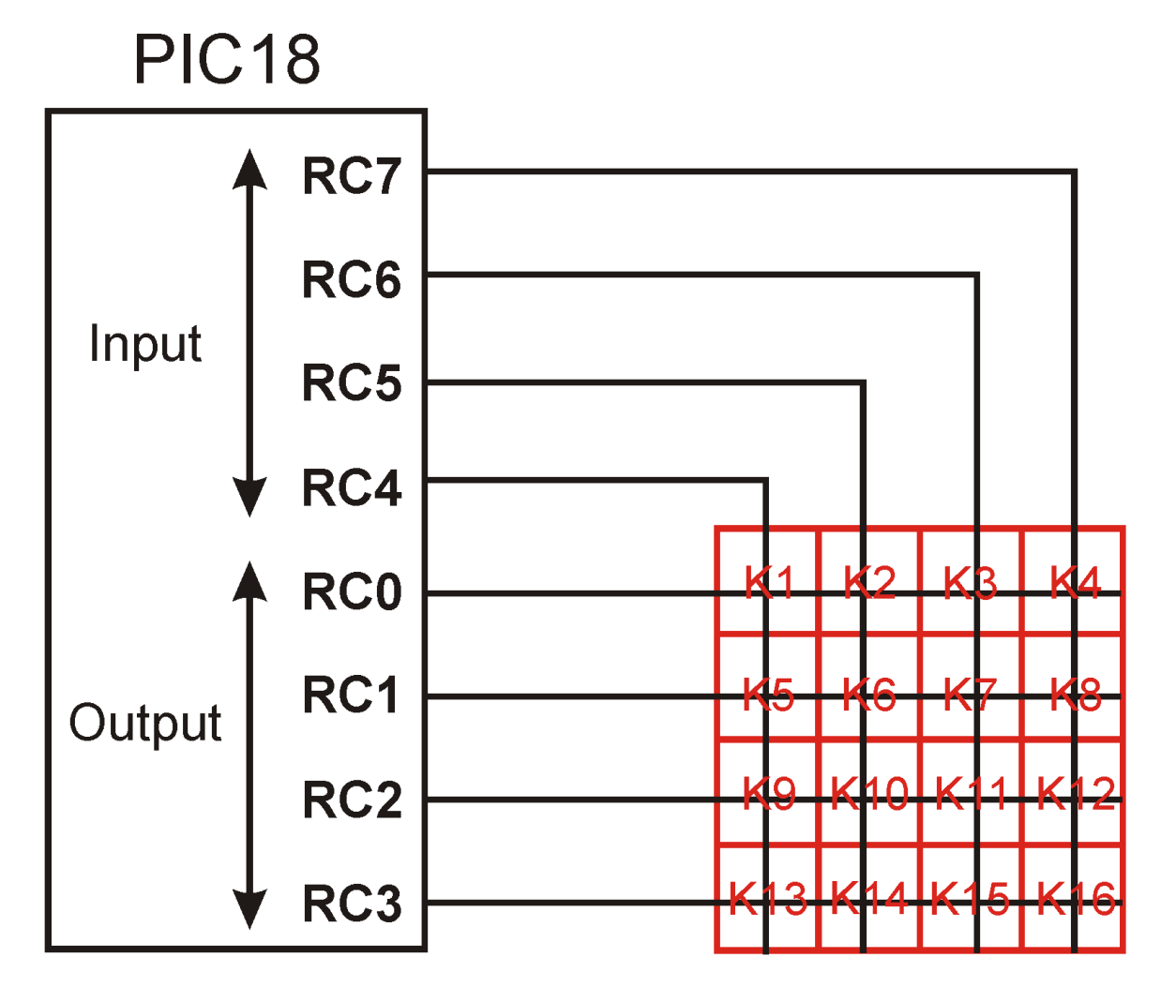
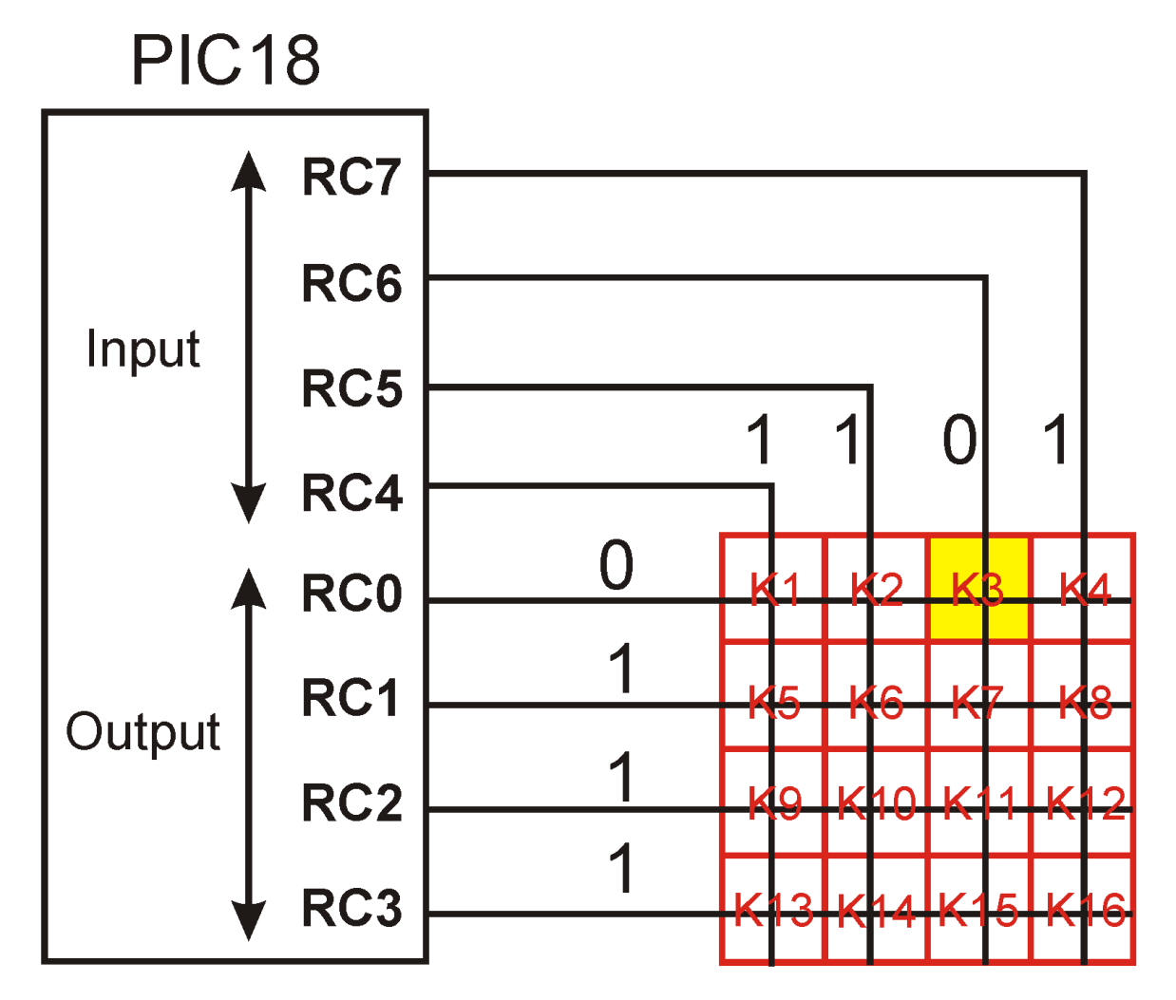
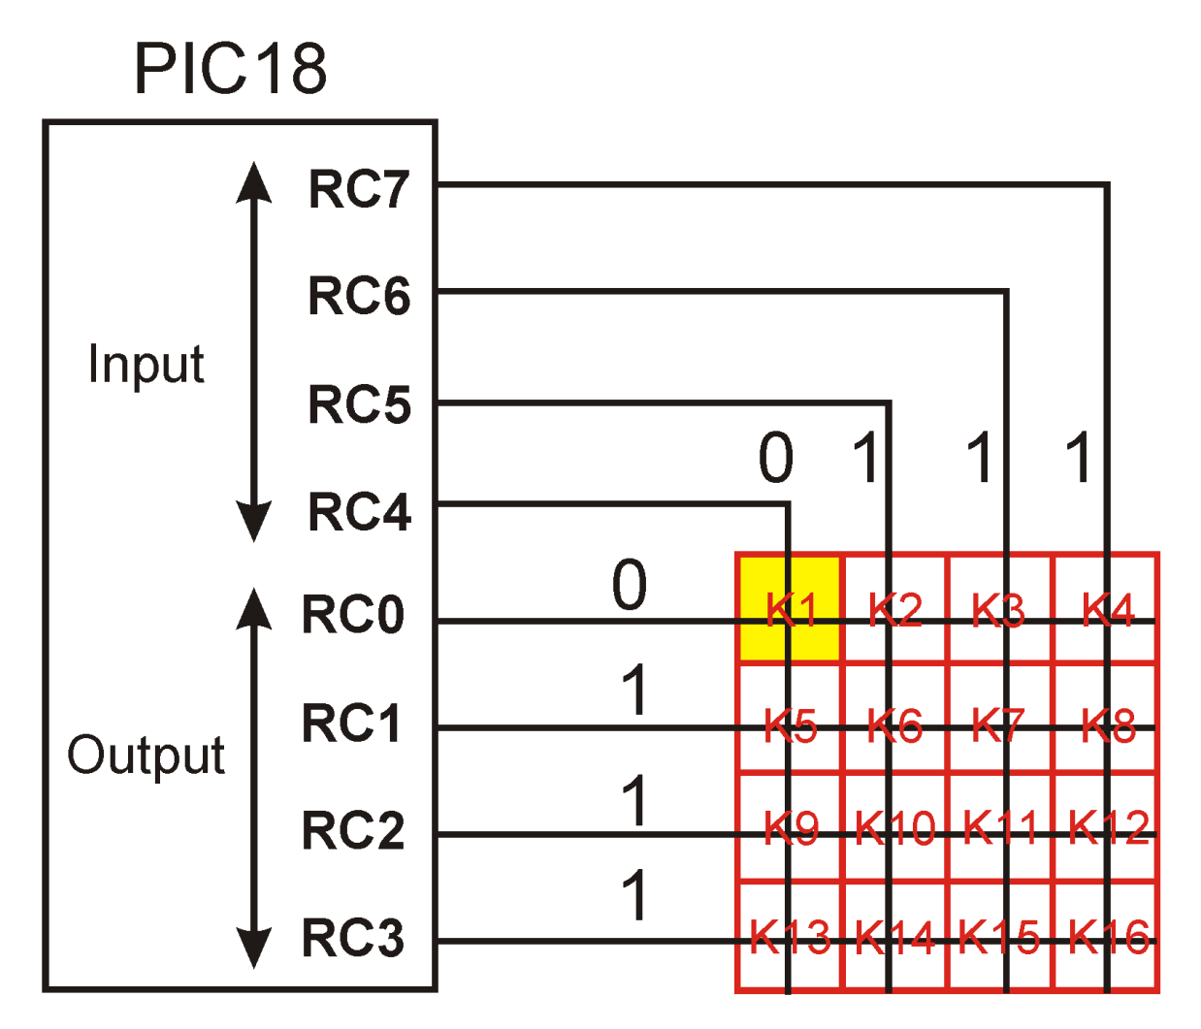
Interfacing with Keypad

Slide 46
Interfacing with Keypad
The basic idea is to scan each row.
Suppose I want to check if one of (k1to k4) is pressed.
Set RC0 to 0, and then read RC4-RC7. If one of RC4-RC7 is 0, find out the corresponding pressed key.
Repeat the above procedure for each row.
Of course, in the program, we need

Slide 47
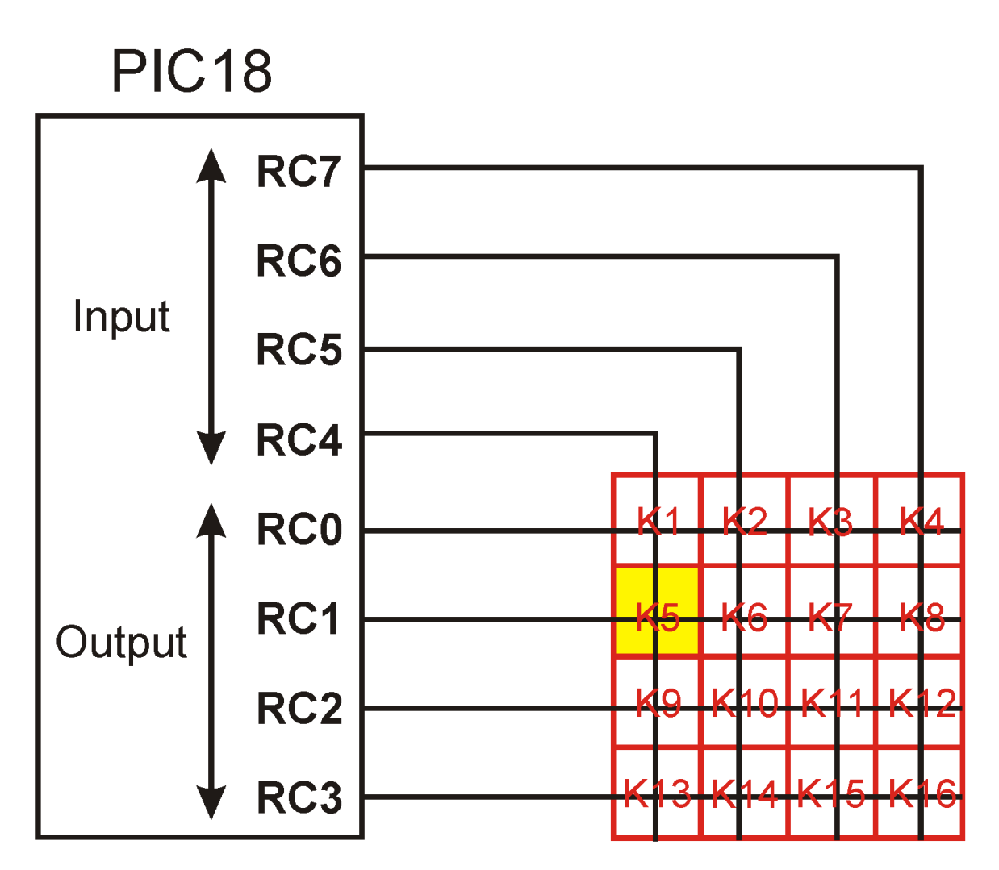
When K5 is pressed
1
1
1
0
1
0
1
1
0
1
1

Slide 48
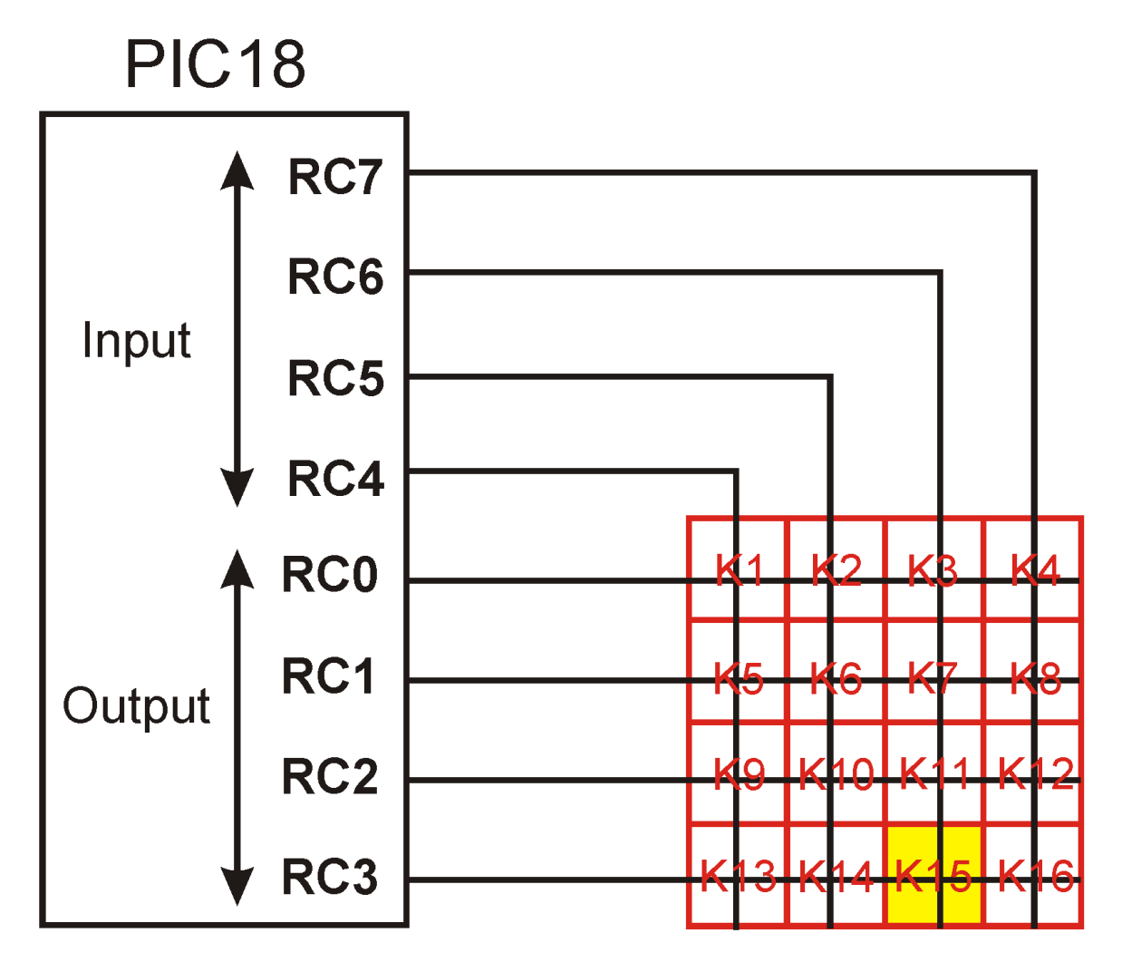
When K15 is pressed
1
1
1
0
1
0
1
1
0
1
0
1
0

Slide 49

PICkit3
Device Programmer – Burn assembled code into the device FLASH.
In-circuit debugger – allow real-time interactions with the board even when debugging.

Slide 50
I/O ports and bit-addressability
Often need to access individual bit of the port instead of the entire 8 bits.
PIC18 provides instructions that alter individual bits without altering the rest of the bits in the port.
Most common bit-oriented instructions:
Instructions | Function
bsf fileReg, bit | Bit Set fileReg
bcf fileReg, bit | Bit Clear fileReg
btg fileReg, bit | Bit Toggle fileReg
btfsc fileReg, bit | Bit test fileReg, skip if clear
btfss fileReg, bit | Bit test fileReg, skip if set

Slide 51
bsf, bcf and btg
bsf fileReg, bit
e.g., bsf PortB, 5 sets Bit 5 of Port B to be 1
bcf fileReg, bit
e.g., bcf PortB, 5 sets Bit 5 of Port B to be 0.
btg fileReg, bit
e.g., btg PortB, 5 toggles Bit 5 of Port B (i.e., sets it to 1 if the current value is 0 & vice versa)

Slide 52
Checking the state of an I/O port
btfsc (bit test file, skip if clear) and btfss (bit test file, skip if set) are used to make branching decision based on the status of a given bit.
e.g., btfsc PORTD, 2 skips the next instruction if Bit 2 of Port D equals 0.
e.g., btfss PORTD, 2 skips the next instruction if Bit 2 of Port D equals 1.

Slide 53
Example: btfss
e.g., Write a program to (a) keep monitoring RB2 bit until it becomes high (b) When RB2 becomes high, write 45H to Port C
bsf TRISB, 2; set RB2 as input
clrf TRISC; set Port C as output
movlw 0x45
Again: btfss PORTB, 2
bra Again
movwf PORTC

Slide 54
Example: btfss
e.g., Write a program to check RB2.
If RB2 = 0, send the letter ‘N’ to Port D
If RB2 = 1, send the letter ‘Y’ to Port D
bsf TRISB, 2; set RB2 as input
clrf TRISD; set Port D as output
Again: btfss PORTB, 2
bra Over
movlw A’Y’
movwf PORTD
bra Again
Over: movlw A’N’
movwf PORTD
bra Again

Slide 55
Example: btfsc
e.g., Perform the same function using btfsc
bsf TRISB, 2; set RB2 as input
clrf TRISD; set Port D as output
Again: btfsc PORTB, 2
bra Over
movlw A‘N’
movwf PORTD
bra Again
Over: movlw A‘Y’
movwf PORTD
bra Again

Slide 56
Sections
3.1 Loop and Jump Instructions
3.2 IO PORT
3.3 Time Delay Generation and Calculation

Slide 57
Time Delay
We have written a delay subroutine in Ex3-8.
How to calculate exact delays？
How to generate various time delay？

Slide 58
Machine Cycle
For the CPU to execute an instruction takes a certain number of clock cycles.
In the PIC18 family, these clock cycles are referred to as instruction cycles.
In PIC18, 4 clock cycles=1 machine cycle
Different instructions take need different machine cycles
Notes:
quartz 石英
crystal 水晶
oscillator:振盪器
The pin of 8051 for external clock => look Chapter 4.

Slide 59
Example
The following shows crystal frequency for three different PIC18 based systems. Find the period of the machine cycle in each case.
4 MHz (b) 16 MHz (C) 20 MHz
Solution:
4/4=1MHz, 1MC=1 μs (microsecond)
(b) 16/4 MHz = 4 MHz
machine cycle (MC) = 1/4MHz=0.25 μs
(c) 20 MHz/4 = 5 MHz
MC = 1/5 MHz = 0.2 μs

Slide 60
Example
For a PIC18 system of 4MHz11.0592 MHz, find how long it takes to execute each of the following instructions.
(a) MOVLW (b) DECF (c) MOVWF (d) ADDLW
(e)NOP (f) GOTO (g) CALL (h) BNZ
Solution:
The machine cycle for a system of 11.0952 MHz is 1.085 μs.
Table A-1 shows machine cycles for each instructions.
Instruct Machine cycles Time to execute
(a) MOVLW 1 1×1 μs = μs
(b) DECF 1 1×1 μs = μs
(c) MOVWF 1 1×1 μs = μs
(d) ADDLW 1 1×1 μs = μs
(e ) NOP 1 1×1 μs = μs
(b) GOTO 2 2×1 μs = μs
(c) CALL 2 2×1 μs = μs
(d) BNZ 1 or 2 1 or 2 μs
BNZ takes 2 MCs if it jump, and takes 1 MC when falling through. (The pipeline is clear if jump)

Slide 61
Example
Find the size of the delay in the following program, if the crystal
frequency is 4 MHz.
MC
MYREG EQU 0x08
DELAY: MOVLW 0xFF 1
MOVWF MYREG 1
AGAIN : NOP 1
NOP 1
DECF MYREG, F 1
BNZ AGAIN 2
RETURN 1
[(255 × 5)+1+1+1] × 1 μs = 1278 μs.
Note that BNZ takes two MCs if it jump, and take only one when falling through the loop. The actual time is 1277 μs.

Slide 62
Example
Find the size of the delay in the following program, if the crystal
frequency is 4 MHz.
MC
R2 EQU 0x7
R3 EQU 0x8
DELAY
MOVLW D’200’ 1
MOVWF R2 1
AGAIN MOVLW D’250’ 1
MOVWF R3 1
HERE NOP 1
NOP 1
DECF R3, F 1
BNZ HERE, 2
DECF R2, F 1
BNZ AGAIN 2
RETURN 1
For HERE loop, the delay is 5x250=1250μs. The AGAIN loop repeats the HERE loop 200 times. Therefore, we have 200x1250=250 000 μs. (without overhead)
Overhead=5x200-200 + 1 + 1 + 1 – 1
The delay = 250 ms + 0.8 ms = 250.8 ms.

Slide 63
Example
Write a PIC18 code to generate 1 second delay. The crystal frequency is 10 MHz.
Solution:
10 MHZ => 1 MC = 400 ns. `1 second’ needs 2,500,000 MCs
If we have a basic loop with 5 MC. That means, we may need to execute this
basic loop 500,000 times. 500,000 can be decompose as 20x100x250
DELAY: MOVLW D'20'
MOVWF R4
BACK MOVLW D'100'
MOVWF R3
AGAIN MOVLW D‘250'
MOVWF R2
HERE NOP
NOP
DECF R2, F
BNZ HERE
DECF R3, F
BNZ AGAIN
DECF R4, F
BNZ BACK
RETURN
END

Slide 64
You are able to (1/2)
Code PIC18 Assembly language instructions using loops
Code PIC18 Assembly language conditional jump instructions
Explain conditions that determine each conditional jump instruction
Code GOTO/BRA jump instructions for unconditional jumps

Slide 65
You are able to (2/2)
Calculate target addresses for jump instructions
Code PIC subroutines
Code PIC IO ports
Discuss crystal frequency versus machine cycle
Code PIC programs to generate a time delay

